Slide 1
National priorities and municipal voices: An update from FCM First Vice-President Tim Tierney
Presentation to the Union of Municipalities of New Brunswick
2025 UMNB Annual Conference and AGM

Slide 2
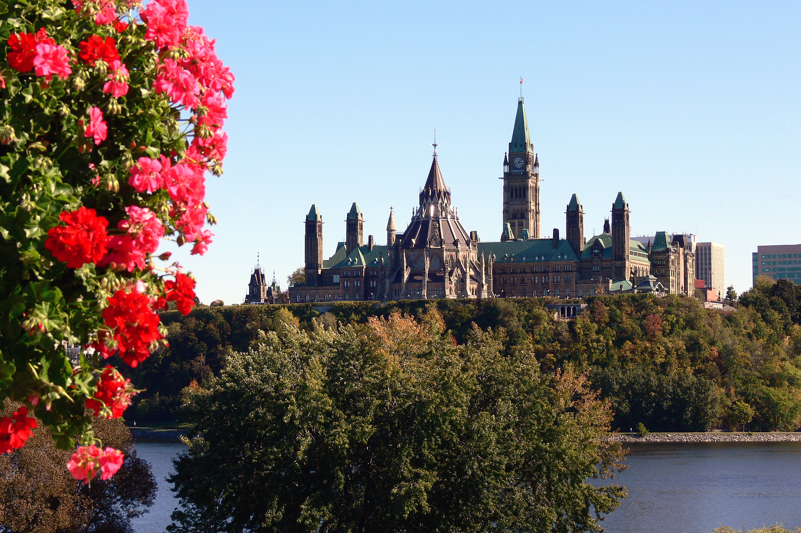
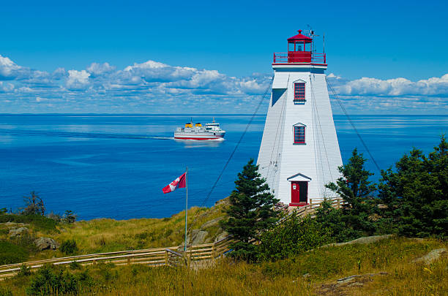
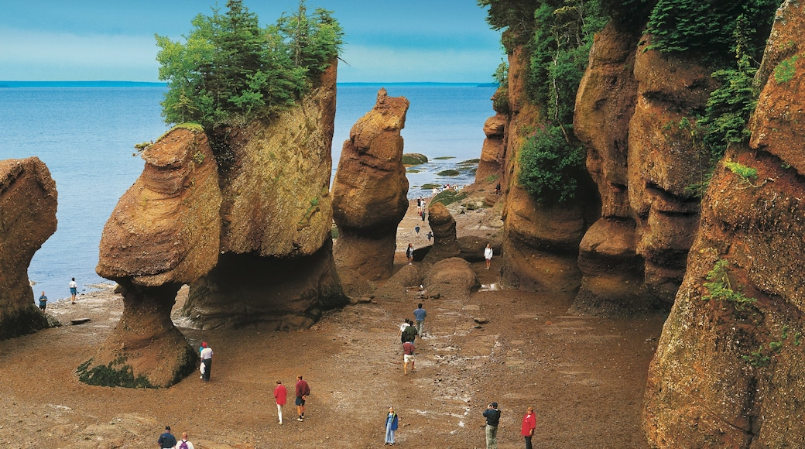

Context
  Crucial moment in time for Canada’s municipalities
  The House has returned
  Budget 2025 expected by November 4th
  Pressure to move quickly, deliver results rapidly:
    Economic resilience, “nation-building” infrastructure
    Housing, Build Canada Homes
    Public Safety
    Defence
  Austerity context, goal to cut operational spendings:
    7.5% : 2026-2027 fiscal year
    10%: 2027-2028 fiscal year
    15%: 2028-2029 fiscal year

Slide 3

Canada’s municipalities are ready to act as fully committed and equal partners to this government

Slide 4
FCM’s Advocacy Priorities
Build Canada by Investing in Local Infrastructure
Build Housing and Address Homelessness
Strengthen Local Economic Prosperity and Climate Resilience
Improve Public Safety

Slide 5
Housing and Homelessness
Over 44% of Canadians cited housing affordability as their top concern. This is an ongoing issue across Canada, and it is no different in New Brunswick.
We know you have the solutions to this matter, with forward thinking initiatives seen across the province
Official announcement of Build Canada Homes:
  Federal government must stay the course, amplify the agency’s capacity.
  Working with municipalities: crucial in order to build 500,000 new homes
FCM is calling for:
  Increased supply of non-profit and affordable housing
  Better use of public land for supportive housing
  Opportunity for prefabricated & modular housing
  Calling for a municipal intake to coordinate housing

Slide 6
Local Infrastructure
Building more houses must come with more infrastructure that make houses homes.
Essential to the success of Canadian businesses, enterprises and economic projects, support the vast number of new homes
Great amount of pressure put on NB in this regard: effects of trade war on businesses, forestry, seafood industries
Municipalities maintain 60% of our nation’s vital infrastructure, but get only 8¢/tax dollar
Chronic underfunding = long-term risk
As the federal government contemplates the next generation of infrastructure funding, FCM is advocating for an expanded, GDP-indexed Canada Community Building Fund (CCBF), working with provinces and territories to match

Slide 7
Public Safety
Everyone deserves a community where they feel safe and supported.
FCM calls for:
  Bail reform on repeat offenders
  Stronger RCMP funding and staffing
  Proper municipal consultation on policing contracts
  More investment in community mental health supports

Slide 8
Local Economic Prosperity and Climate Resilience
The need for climate-resilient infrastructure and stronger environmental protections is now.
Historic year for wildfires in Atlantic Canada, including in NB
FCM is calling for:
  $2B initial federal investment to safeguard local economies and protect Canadians
  Reinvestment in the Green Municipal Fund (GMF)

Slide 9
How We Make Progress
Federal momentum: great opportunities for municipalities
Collaboration between FCM & PTAs like UMNB will be essential in this regard
How you can contribute:
  Join FCM’s board or committees
  Amplify FCM messages via MPs, media, social channels
Together, we can ensure that the voices and needs of NB municipalities are heard in Ottawa loud and clear

Slide 10

Conclusion
This is a unique moment in time for New Brunswick’s municipalities.
Let’s lean into the opportunities in front of us to make a difference and shape the future of our country.

Slide 11
Comments and questions are welcome!
For more information visit fcm.ca

Slide 12


