Slide 1

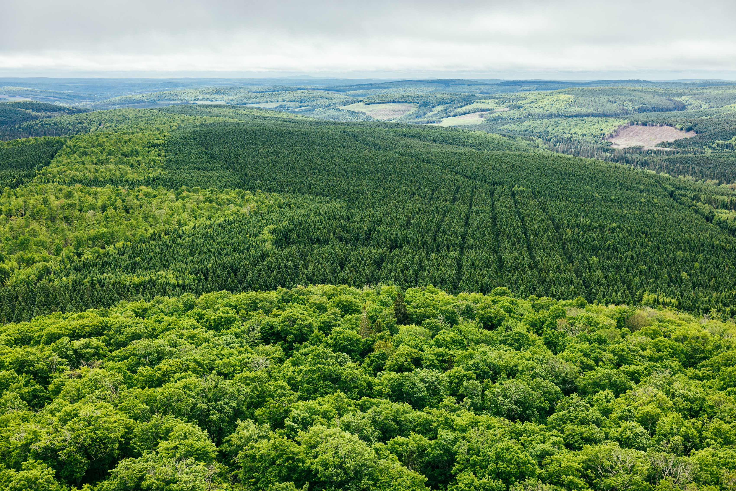


Forestry – New Brunswick’s Most Important Industry
UMNB October 2025

Slide 2
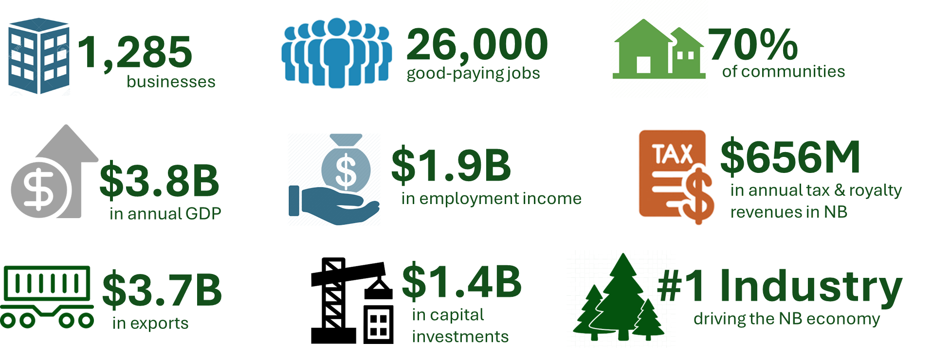
Contributions of the forest sector hinges on balanced policy
NB WORKING FORESTS THE FOUNDATION OF THE INDUSTRY
need balanced forestry policy & competitive operating environment
Source: Jupia Consultants

Slide 3
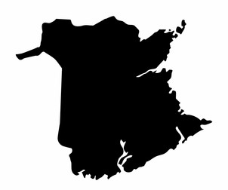


The NB Forest Value Chain No other industry has as distributed an economic footprint in the province
139
141
76
1,285 firms in the NB forest products sector
83
139
77
68
157
46
125
30
21
116
# of firms by county
31
35
NIACS Codes: 113, 321, 322, 1153, 4156, 4182, 337110, 337121, 337213, 337223, 484223, 484233 (Stats Canada, December 2024)
Source: Jupia Consultants

Slide 4

How much is $656 MILLION in provincial and municipal tax revenues & royalties?
$656M is enough to cover:
Annual Taxes & Royalties
130% of the annual operating budget of the NB Department of Transportation and Infrastructure.
194% of the salaries of all physicians and veterinarians. 102% of the total salaries of the nursing workforce.
163% of the provincial funding for post-secondary education (universities & colleges).
93% of the total salaries for schoolteachers - secondary, elementary and kindergarten teachers.
175% of the NB Justice and Public Safety budget.
$76M
$112M
Source: Jupia Consultants

Slide 5
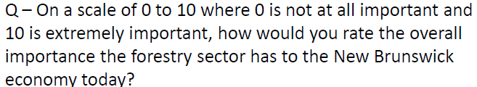
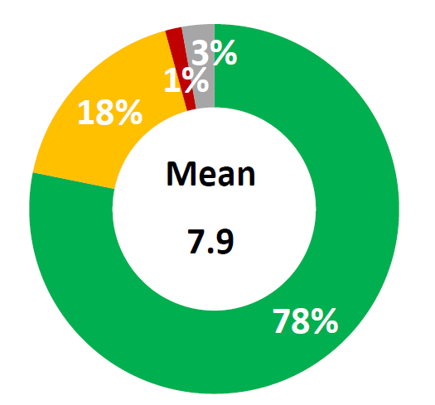
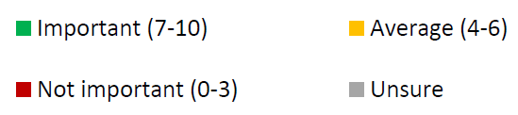
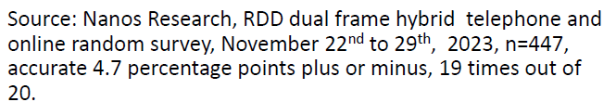


Public Opinion The vast majority of New Brunswickers feel the forest industry is very important
Level of Importance of the Forest Sector to the NB Economy
AVERAGE
7.9 out of 10

Slide 6




The value of harvested wood to NB
$427
in provincial GDP
$209
in employment income
One cubic metre of harvested wood generates:
in Provincial and Municipal taxes + royalties
$73
($61 provincial + $12 municipal)
Source: Jupia Consultants

Slide 7


ILLUSTRATION Understanding the impact of reducing wood supply on NB Crown Land
Conservation Forest
25%
Conservation Forest
Conservation Forest
8%
34%
Since 1982 the government has forgone:
2.4M M3 of wood/year
$175M in tax revenue/year
The 2022 Nature Legacy strategy has forgone an additional:
900K M3 of wood/year
$66M in tax revenue/year
Assumptions: current tax rate across all years, forest productivity is constant
Notes:
Assumes current tax rates apply across all years (Jupia Consultants 2025) Assumes forest productivity is constant at 3 m³/ha/yr Conservation forest includes inoperable areas, but not wetlands

Slide 8

NB Minister of Natural Resources Shared Landscapes Initiative
The Shared Landscapes Initiative commits to achieving 15% protected lands and waters in New Brunswick by 2027.
10% → 15%
Crown lands account for ~50% of province
Thus, 15% in NB = ~30% on Crown lands
Licencees were asked to submit a plan by October 3rd, 2025

Slide 9
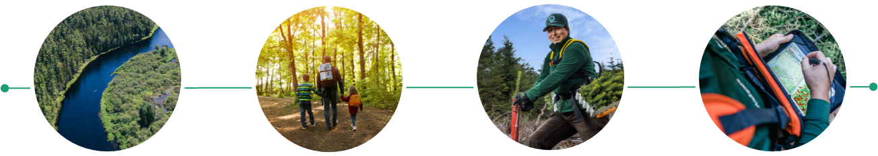
Shared Landscapes Initiative
Our Balanced Forestry Management Plan
Crown License 7
Exceeds conservation target of 15%
Increases public support for the sector
Improves the competitiveness of the sector
Ensures a healthy environment & biodiversity
Count the conservation lands we already have
Add connectivity, water & wetland protection
Add new “social impact areas” for tourism, drinking water supply, and public concerns
Consolidate more operations in forest-dependent areas
Return some working forest area near forest dependent communities with swaps in “high social impact” areas ​
Implement world-class biodiversity monitoring
Exceed the “acceptable” old forest target

Slide 10

Shared Landscapes Initiative Our Plan – by the #’s
Doing our part on Crown License 7
PLUS
High “social impact” areas
MINUS
Return working forests near forest-dependent communities
Count what we already have
swaps
Current accounting
+ 131,000 ha
+ 92,000 ha
- 32,000 ha
Only count Parks, Protected Natural Areas & Nature Legacy
Add water buffers, wetlands, and unique sites
Add new community areas, tourism, drinking water supplies, more forested wetlands
Minus return of some working forests to achieve a balance of objectives

Slide 11

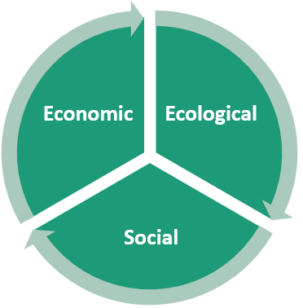

What do we need from you?
We have a plan. But it will require political will to implement
We need municipalities to actively support the plan with Minister Herron to make the change.
Our Balanced Forest Management Plan:
Exceeds the Shared Landscapes Initiative conservation target of 15%
Counts what we have + new water protections + new social impact areas
Swaps are KEY: Add social impact areas → Return working forest areas
Achieves a balance – economic, ecological, and social
Your vocal support means letters, phone calls, meetings. Thank you.

