Slide 1







Leading Change in Uncertain Times:
A Practical Guide for Municipal Leaders
October 2025
Presented by: Heather Stamp

Slide 2





The Challenge of Change Conversations
Communicating a property tax increase to skeptical residents
Managing friction from provincially mandated changes
Giving difficult performance feedback
High stake, high emotions – trust is on the line
Announcing a cut to a popular service (e.g. facility closure)

Slide 3




Session Roadmap
Frameworks We’ll Explore
  ADKAR (what leaders must build)
  The Change Curve (what people experience)
  Crucial Conversations & DiSC (how we show up)
  The “Reframe” Script (step-by-step approach to tough conversations)

Slide 4

Which word comes to mind about change conversations in your municipality?

Slide 5
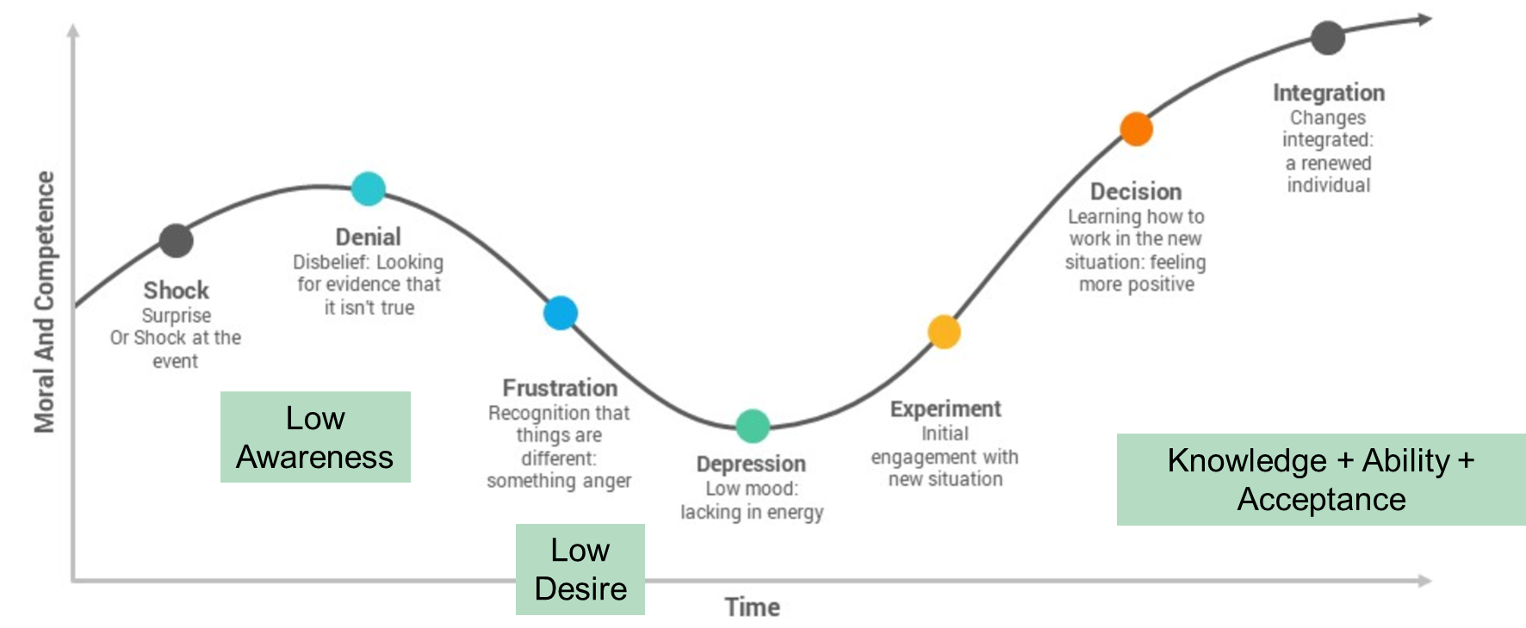

What is The Change Curve: Navigating Emotions of Change
Kubler Ross Change Curve

Slide 6
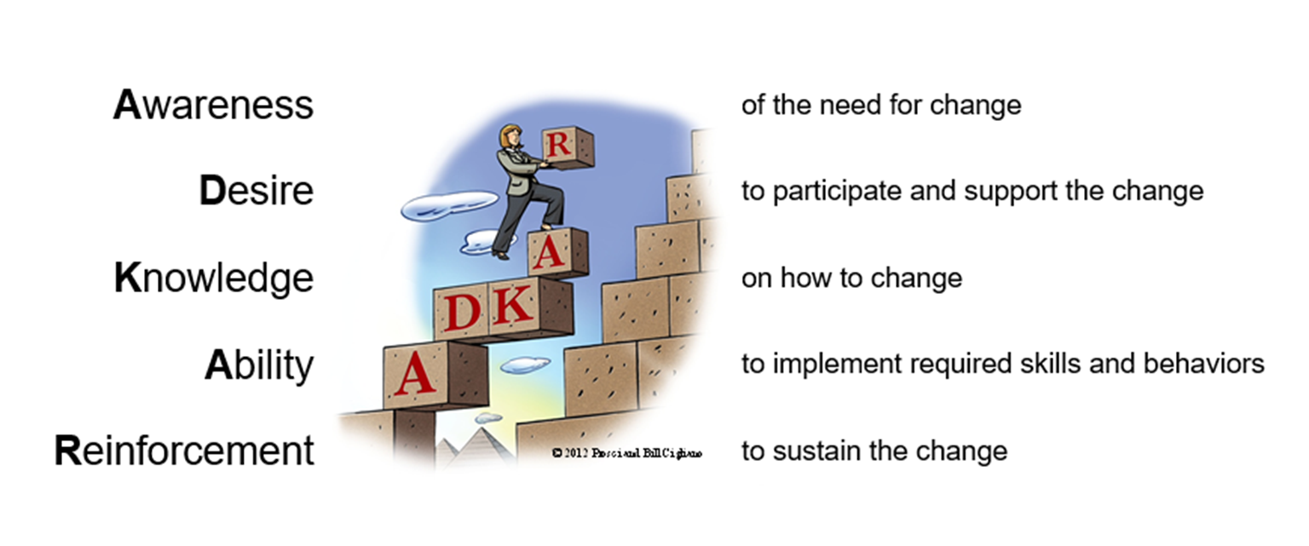

ADKAR: A Change Model
Leader Involvement
Notes:
Recruitment and hiring are critical processes that determine organizational talent. Leaders should be involved in developing criteria and participating in the selection process to ensure alignment with company culture.

Slide 7
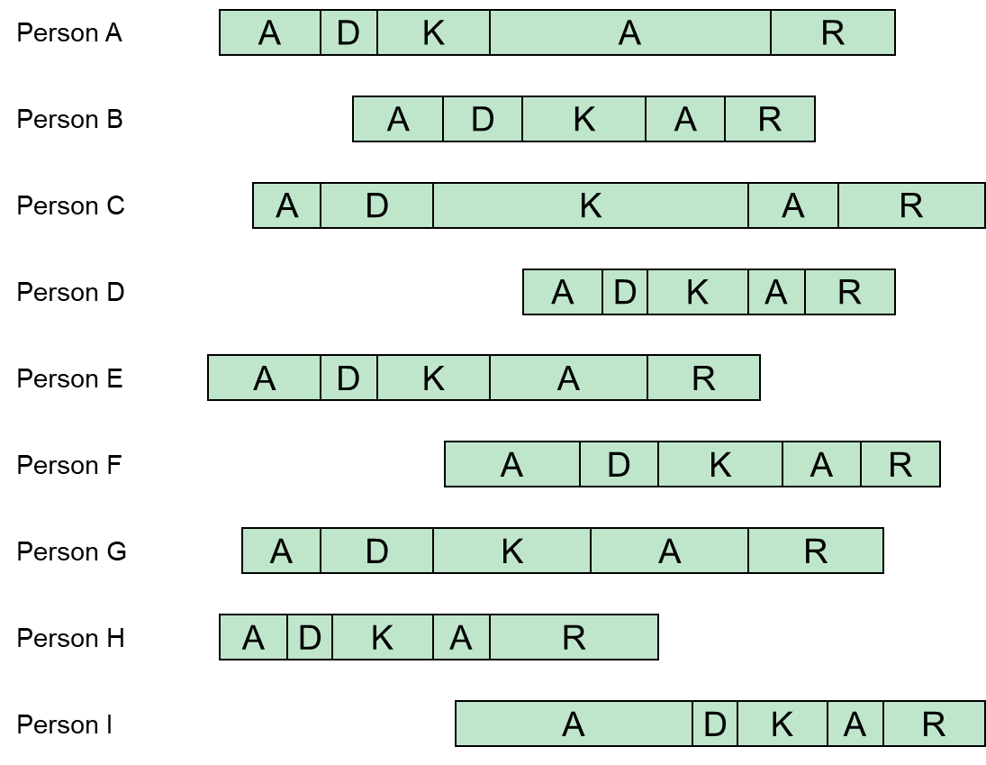

Not Everyone Changes At The Same Pace

Slide 8
What is the biggest barrier to effective change conversations in your experience?

Slide 9



Start with Facts
Crucial Conversations: Core Concepts
Facts are less controversial – avoid assumptions and jumping to blame
Psychological Safety
Foster trust so everyone feels safe to speak
Mutual Purpose
Show you care about their goals
Welcoming Environment
Show you care about them as people

Slide 10


The Reframe Script: Turning Conflict into Collaboration
Step 1: Acknowledge the Emotion
Validate what they feel (anger, fear, etc.)
Step 2: Explain the Why
Share the reasoning or context behind the change
Step 3: Offer a Next Step
Focus on a constructive path forward (solution, action, follow-up)

Slide 11

Bringing It All Together – Key Takeaways
Anticipate the Journey
  People may deny or resist change before accepting it
  Normalize these reactions
Build ADKAR blocks proactively
  If one ADKAR block is missing, resistance fills the gaps
Create Safety
  Ensure mutual purpose and respect upfront
  Lead with facts to avoid unnecessary conflict
Reframe, Don’t Reach Impasse
  When hit with anger or fear, acknowledge it, explain the context, and move to solutions
Organizational Integrity
Compliance
Equitable Workplace

Slide 12
“The art of leadership is guiding your team though conversation - one honest dialogue at a time”
Real Change Happens Through Real Conversations

Slide 13


Let’s Chat
Leadership and Team Development
Executive and Team Coaching
Conflict Resolution and Mediation
Governance and Organizational Strategies
Heather Stamp
Senior Advisor, People & Culture
heather.stamp@mcadvisory.com
Notes:
Throughout this presentation, we will discuss the critical importance of HR, key HR functions that every leader should be familiar with, compliance and risk management, and effective communication and conflict resolution strategies. This knowledge is crucial for effective leadership.

Slide 14


Thank You
For Your Attention

