Slide 1
Best Practices for Recruiting and Hiring Municipal Staff
Presented by MC Advisory and McInnes Cooper
Addressing workforce challenges in NB municipalities through innovative strategies for recruitment, onboarding, and retention.
Presented by Tanya Tynski & Chris Pelkey

Slide 2
Current Workforce Challenges in NB Municipalities
Aging Workforce
Approximately 22% of the workforce 55+
Young NB’ers are starting work later
Knowledge gap
Private Sector Competition
Municipalities struggle to compete with private companies for specialized talent.
Evolving Skills Requirements
Modern municipal roles demand new technical and digital competencies.
Limited Resources
Budget constraints affect competitive compensation packages and recruitment efforts.

Slide 3
Innovative Recruitment Strategies
Digital Engagement
Leverage social media platforms and municipal websites to showcase workplace culture and career opportunities.
Meaningful Impact
Emphasize public service value and community contribution in job descriptions and interviews.
Educational Partnerships
Develop internship programs with colleges to create talent pipelines for hard-to-fill positions.
Employee Referrals
Implement programs rewarding staff who refer qualified candidates who are successfully hired.

Slide 4
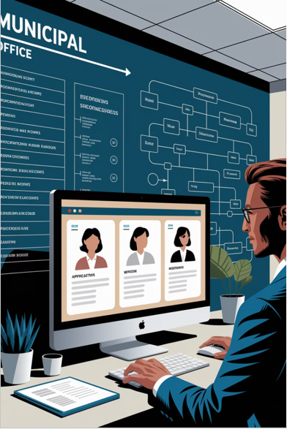
Streamlining the Hiring Process
Focus Recruitment Efforts
Step out of the traditional – think about your target candidates, what channels will reach them, salary?
Structured Interviews
Competency-based questions ensure fair comparisons between candidates. Rating Guides are important.
Targeted Assessments
Job-specific tests evaluate technical skills and cultural alignment
Positive Experience
Clear communication and respect for candidates builds municipal reputation.

Slide 5
Effective Onboarding Practices
Preparation
First Day
First Month
First Quarter
Set up workspace, technology, and welcome materials before day one.
Introduce team members, provide tour, and review essential policies.
Assign mentor, schedule check-ins, and provide role-specific training.
Review progress, gather feedback, and adjust development plan as needed.

Slide 6
Retention Strategies
Competitive Compensation
Regular market analysis ensures salary and benefits packages remain attractive compared to similar positions.
Professional Development
Learning opportunities and clear advancement paths show investment in employee futures.
Recognition Programs
Formal and informal acknowledgment of achievements boosts morale and engagement.
Positive Culture
Regular team activities and open communication foster belonging and purpose

Slide 7
Key Takeaways and Next Steps
1
Prioritize People Strategy
Allocate sufficient resources to recruitment and retention initiatives.
2
Embrace Innovation
Implement modern technologies and approaches to attract digital natives.
3
Focus on Experience
Create inclusive environments where diverse employees feel valued.
4
Continuous Improvement
Regularly assess hiring processes and adjust based on outcomes.

Slide 8
5 Key Hiring Do’s & Don’ts
Put the up-front time in

Slide 9
1. Do Use Employment Application
(Permissible) Specific Information
(Carefully drafted) Binding Acknowledgement of Truthfulness

Slide 10
2. Don’t Ask Discriminatory Questions
Do you plan to have kids?
What does your wife do for a living?
Is that your married name?
Is English your first language?
Does your family eat turkey or ham for Easter dinner?

Slide 11
3. Do Take Care with Social Media Screening
Do you know who you’re looking for
Is it reasonable in the circumstances
Should it be in-house or out-sourced
Do you have consent (ideally on the application form or @ the interview)

Slide 12
4. Do Speak Carefully
“Inducement”
Notice entitlement

Slide 13
5. Do Use Written Employment Contracts
Key Terms
Set @ time of hiring
Avoid disputes, costs & time
Facilitation of end of employment relationship

