Slide 1
Lifting Up Local Communities
Molly Cormier, Director of Brand and Communications
Notes:
Good afternoon, my name is Molly Cormier. I am the Director of Brand and Communications at Atlantic Lottery and I’d like to speak with you today about how we strive to lift up local communities.

Slide 2
Our Purpose
Our Vision
To delight players and make a meaningful contribution to all Atlantic Canadians, with whom we share a common bond, the joy of play and our love of this place.
To be a world-leading, responsible, digital gaming experience company driven by the higher purpose to give back.
Notes:
Atlantic Lottery exists to build a stronger Atlantic Canada and has been supporting local communities for close to 50 years now. As a publicly owned corporation, Atlantic Lottery’s mandate has always been driven by giving back.
That’s why our purpose and our vision both speak to making a contribution to Atlantic Canadians and our region.
We are the only 100% legal and government-regulated provider of lottery, online gaming and sports betting in the region. Players can be proud to play with us, knowing that 100% of lottery profit stays right here in our region to help fund services essential to Atlantic Canadians and positively impact our economy.
That’s reflected in our purpose, which is to delight players and make a meaningful contribution to all Atlantic Canadians, with whom we share a common bond, the joy of play and our love of this place.
Our vision is to be a world-leading responsible, digital gaming experience company driven by the higher purpose to give back, and we’ll discuss this more in just a few minutes.
------

Slide 3
Notes:
100% of lottery profit is returned annually to our region, however, a lot more than just the profit stays in our region to benefit our economy. In this record year, $492.2 million was returned to the four Atlantic provinces and we are committed to continue achieving results such as this through responsible growth.
Atlantic Lottery gives back to our region through a number of different avenues beyond profit returned. Prizes awarded to players, jobs and support to inclusive programs at the community level, are all examples of how we strive to make a meaningful contribution to the region.
This breakdown of how Atlantic Lottery’s revenue was allocated in 2022-23 highlights where that money went and reveals that 92 cents of every lottery dollar stayed here in the four Atlantic Canadian provinces.
You can see the percentages allocated to each category on screen, but I want to call out what a few of those numbers look like:
$440.1 million was awarded in prizes to winners from every corner of Atlantic Canada last fiscal year.
$121.7 million was earned by our over 3,600 Atlantic Canadian retailers from Atlantic Lottery sales – that’s up more than $10 million from the previous year.
Overall operations contributed indirectly to more than 8,300 jobs and $1.9 billion in economic activity across the region.
Atlantic Lottery employs hundreds of individuals all across the four Atlantic provinces. They live, work and spend their salaries in our communities.

Slide 4
New Brunswick in FY23
$153.9 million in profit
358 major wins of $10,000 or more
More than 20 community festivals and events sponsored in N.B.
$31,350 donation to the United Way of Greater Moncton and Southeastern New Brunswick in support of Ukrainian communities in Atlantic Canada
Notes:
We’ve looked at some numbers from across the region, but let’s look at what some of those figures look like for N.B. specifically.
$153.9 million of profit from Atlantic Lottery was returned to the Government of New Brunswick to help fund important social services like education and health care.
New Brunswick had 358 major winners – that’s wins of $10,000 or more. New Brunswick actually saw more major prize winners than any other Atlantic province last year.
We were able to support more than 20 community festivals and events in New Brunswick
And finally, in an additional show of support for our community last year, Atlantic Lottery was pleased to donate $31,350 to the United Way of Greater Moncton and Southeastern New Brunswick to help support Ukrainian communities in Atlantic Canada.

Slide 5
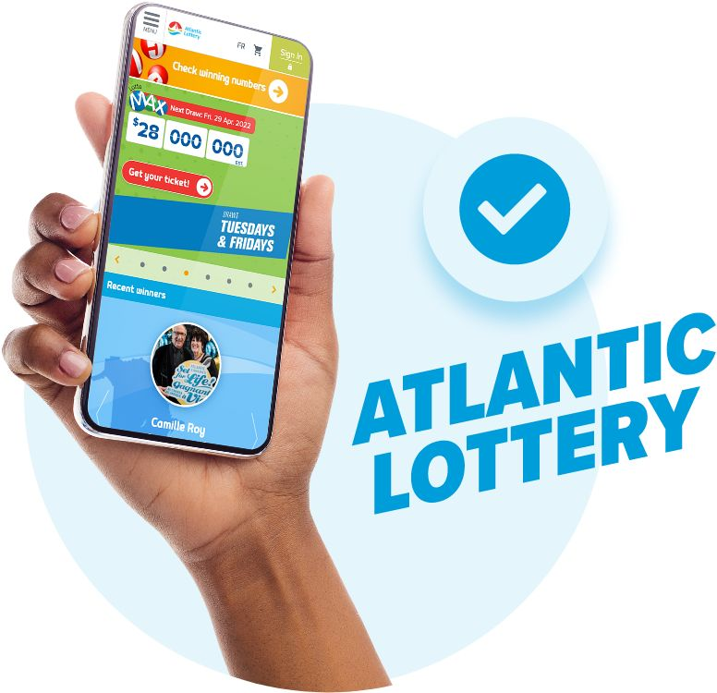
Atlantic Lottery is the only 100 per cent legal and government-regulated online gambling provider in Atlantic Canada
Unregulated gambling sites are not accountable to provincial or federal regulators and their profit does not stay in our region
Atlantic Lottery is set apart by our commitment to healthy play and responsible gambling
Notes:
Atlantic Lottery’s mandate is to provide government regulated and responsible products for those Atlantic Canadians who choose to game and, through that effort, deliver 100% of lottery profits to our four provincial shareholders here in Atlantic Canada to fund essential services like healthcare and education.
Atlantic Lottery is the only 100 per cent legal and government-regulated online gambling provider in Atlantic Canada. However, there has been a huge increase in advertising for illegal gaming websites, creating confusion across the country as research shows many Atlantic Canadians are unaware of whether or not these sites are legal, in part due to significant marketing campaigns that have given them a very high level of commercial visibility.
Although they promote their free “.net” websites, their goal is to redirect players to paid “.com” sites that are not legal under Canadian law. They might claim to be “licensed and regulated” overseas, but only Atlantic Lottery can legally offer online gambling and sports betting in Atlantic Canada.
Right now, it is estimated that about $170 million leaves Atlantic Canada every year due to play on illegal gambling websites. This is money that is leaving our region when it could stay right here to benefit our local communities. These illegal websites are primarily motivated by profit and do not place the same priority on player health and responsible gambling as Atlantic Lottery, nor do they return profits or taxes to Atlantic Canadian provinces.
As a provincially owned public corporation, we have a much higher standard of care than our illegal competitors. It is our commitment to transparency and our accountability to our players and communities that sets us apart.
It is our goal to educate Atlantic Canadian players about the potential risks associated with these illegal operators and repatriate those in our region playing on these unregulated websites in order to ensure the best play experience and to benefit our communities by keeping gaming profit here in our region.

Slide 6
Focus on player education, increased awareness and healthy play tools
Our PlayWise brand helps players to make informed decisions
Our new PlayWise Rating dashboard offers a new way for each and every players to assess their own play
Healthy Play
Notes:
I want to expand on that commitment that Atlantic Lottery has to healthy play, which really sets us apart from our illegal competitors. Atlantic Lottery games are intended to be fun and provide Atlantic Canadian adults who choose to game with a form of entertainment. It’s important to us that our players understand how our games work, decide how much time they want to play and play within their means.
We’re committed to encouraging healthy play, which includes positive, inclusive approaches to player education, increased awareness and providing more tools and interactions to promote play for fun and entertainment.
We continue to improve our healthy play efforts through our PlayWise brand, which helps players make informed decisions by providing information on things like:
• Chance and skill-based games;
• Key gambling facts;
• Understanding the odds;
• Dispelling common gambling myths;
• Healthy play habits; and
• Budget and limit setting
We are also very proud of our recently launched PlayWise Rating dashboard. This tool provides players with a risk-rating based on their play on alc.ca (either low, medium or high risk) as well as access to actual play data like total deposits, wins and losses, time spent on the site and more. Players can also access tools to help manage their time and money spent on alc.ca, like the daily wager limit and session time limit.

Slide 7
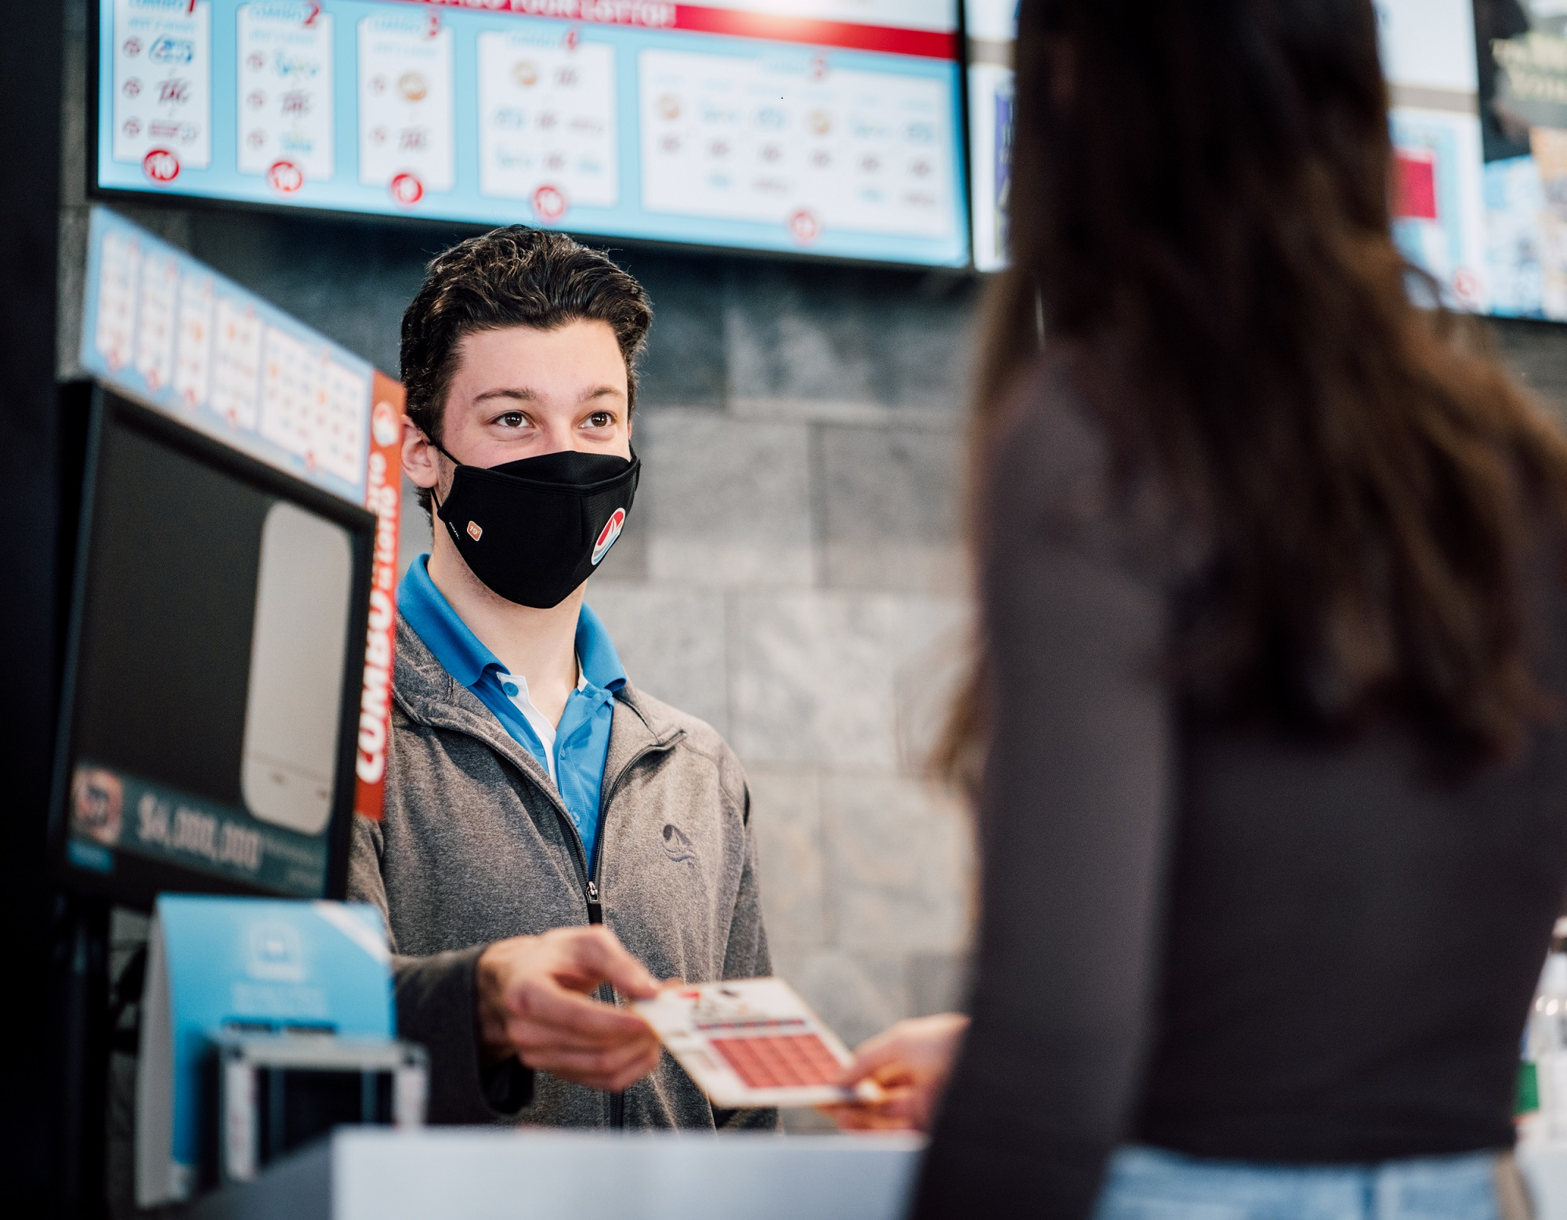
Retail Partnerships
3,600+ independent retail partners
$121.7 million earned in commissions in FY22-23
Innovating new ways to enhance digital and venue spaces
Notes:
More than 3,600 independent Atlantic Canadian businesses earn income from sales of Atlantic Lottery products and serve as the public point of contact for most of our players.
As I mentioned earlier, our retail partners across the region earned $121.7 million in commissions in FY2022-23, which is more than $10 million more than the year prior.
At Atlantic Lottery, we talk a lot about our commitment to being a digital-forward company. We need to have digital growth to remain relevant and compete with the illegal operators that I discussed before. However, that does not mean we have forgotten about our retail partners or intend to leave them behind. Our business simply would not exist today without the commitment and hard work of all our retail partners, and we will always show that commitment right back to them.
We are always exploring new ways to enhance our retail and venue spaces to ensure our customers have the quality, entertaining experiences they expect. One great example of a digital-forward innovation for our retail partners is our new self-serve lottery terminals that you will see in select retail locations now across the region.

Slide 8
#AtlanticWins
$11.6B awarded in prizes across Atlantic Canada to date
In 2022-23:
$440.1M in prizes across Atlantic Canada
892 major prizes of $10,000 or more across Atlantic Canada
358 major prizes awarded to New Brunswickers
Notes:
Since 1976, we’ve handed out $11.6 billion in prizes - as you can imagine, that’s a lot of giant cheques.
Last fiscal year, Atlantic Lottery awarded $440.1 million in prizes to winners from all over the region. 893 Atlantic Canadians won what we call a major prize, which is a prize of $10,000 or more.
As I mentioned on the last slide, New Brunswick had 358 major winners in our last fiscal – that’s more major prize winners than any other Atlantic province in 2022-23.
You can see here just one of our many New Brunswick winners from last year. This is Roger Clark from Oakland, New Brunswick who won $1,000,003 on Lotto Max.
As I’m sure many of you have heard, we still have a very large lottery prize we are waiting to award in New Brunswick. On April 15, 2023 a Lotto 6/49 ticket sold in Gloucester Co., N.B. was a Gold Ball Jackpot winner worth $64 million. This is the largest lottery prize ever won in Atlantic Canada and to date, this prize remains unclaimed. We are eager to meet whoever has this winning ticket so we hope they come forward to claim their prize soon so we can celebrate this big win.

Slide 9
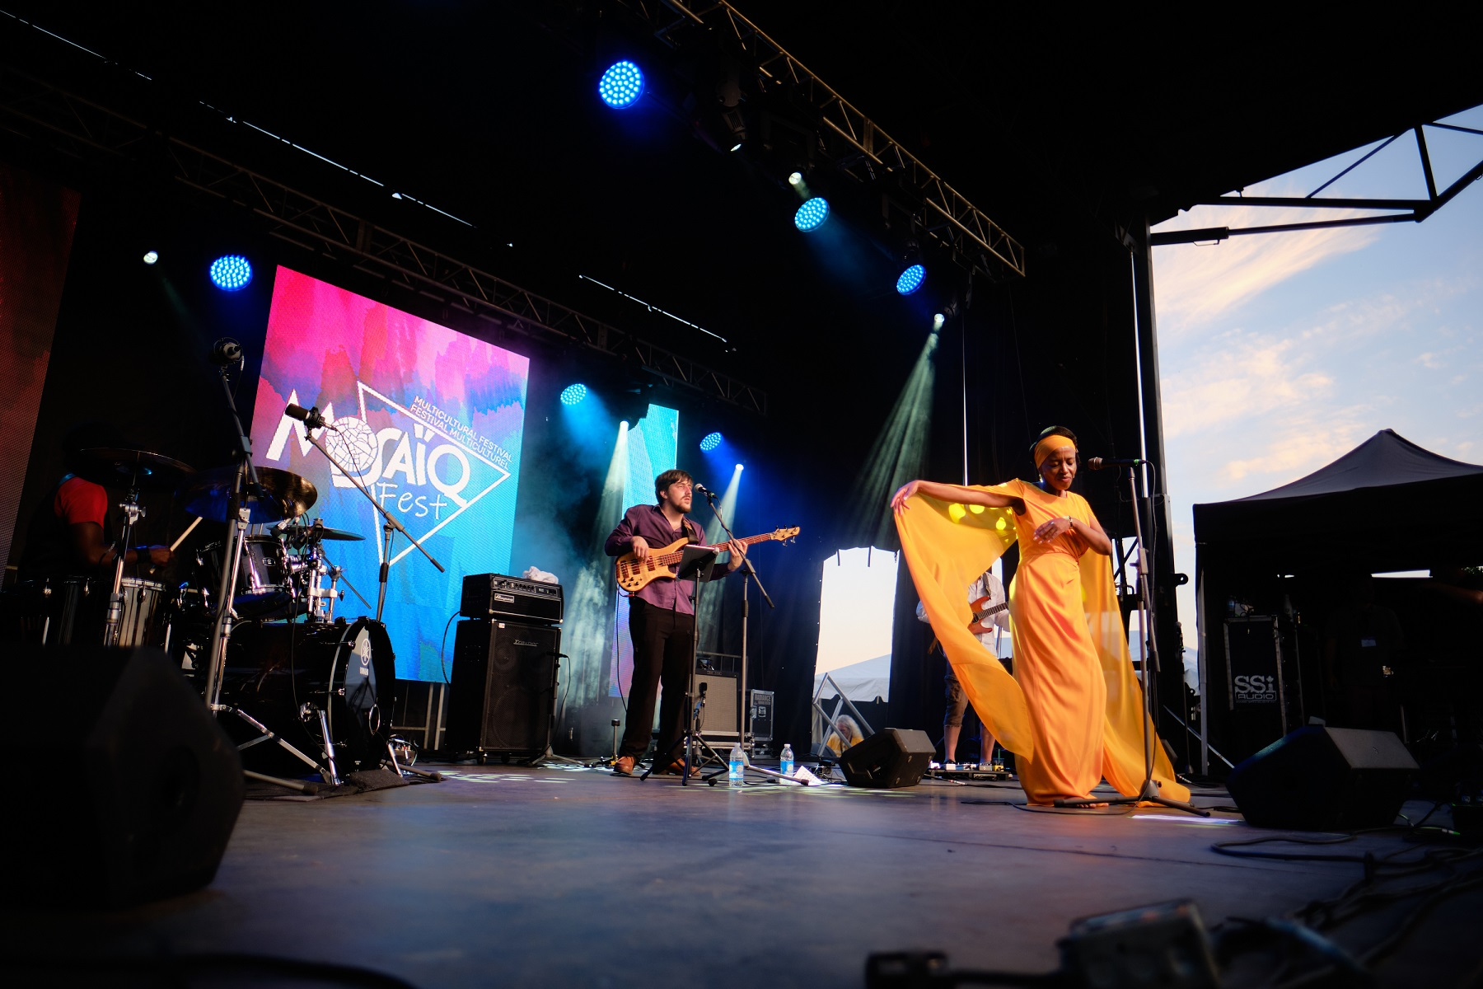
More than 100 community festivals and events sponsored annually
Notes:
Part of Atlantic Lottery’s mandate is to give back to all four Atlantic provinces to help create a better place for everyone who calls this region home, including our employees who live and work here. This means supporting festivals, exhibitions and events that celebrate the culture and diversity of our region.
We also contribute to community organizations, fundraisers and volunteering efforts throughout the year.
After several years throughout the pandemic where there where there were very limited events to support, we are thrilled to have finally had a full roster once again this past fiscal year and were able to support more than 100 community festivals and events.
These events that have important cultural, social and economic impacts across the region and our goal is to reach communities in every corner of Atlantic Canada.
In addition to our Community Festival and Events Program, Atlantic Lottery’s Corporate Sponsorship Program provides financial support to community initiatives with the goal of strengthening the region.
We have formally incorporated inclusion, diversity, equity and accessibility considerations into the selection of events we choose to support and partner with. This ensures our sponsorship program promotes inclusion and reflects the diversity that exists within the region.

Slide 10
Notes:
With that, I want to thank you for your time today and for having us here with you for the UMNB Annual Conference.
At Atlantic Lottery, we believe in leadership in our community and in our business. It’s how we contribute to the good things happening here – we’re not doing it alone; we’re simply doing our part and we appreciate all the incredible things that each and every one of you do for our local communities through the important work you do.
Our 2022-23 Annual Report was released last month and is available on alc.ca. If you’re interested in learning more, you can find additional details about all the things I discussed here today as well as in-depth financial results.

