Slide 1
Soutenir les collectivités locales
Molly Cormier, directrice, Image de marque et communications

Slide 2
Notre Objectif
Notre Vision
Divertir les joueurs et apporter une contribution significative à tous les Canadiens de l’Atlantique avec lesquels nous partageons le plaisir de jouer et notre amour de cet endroit.
Être une société de tout premier plan spécialisée dans le jeu, responsable, numérique, qui cherche en permanence à donner en retour.

Slide 4
2023 au Nouveau-Brunswick
Profit de 153,9 millions de dollars
358 grands gagnants (lot de 10 000 $ ou plus)
Plus de 20 festivals et événements communautaires commandités au N.-B.
Don de 31 350 $ à Centraide du Grand Moncton et du sud-est du Nouveau-Brunswick pour aider les communautés ukrainiennes au Canada atlantique

Slide 5
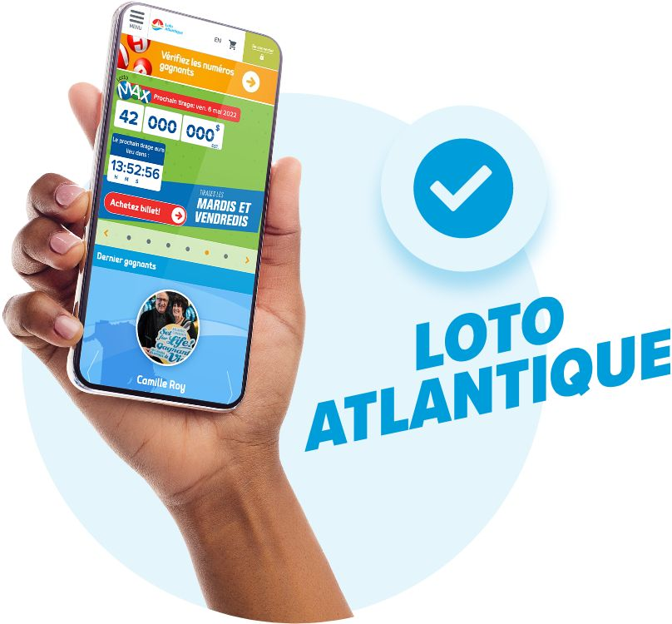
Loto Atlantique est le seul fournisseur de jeux en ligne entièrement légal et réglementé par le gouvernement au Canada atlantique.
Les sites de jeu non réglementés n’ont pas à rendre de comptes aux organismes de réglementation provinciaux ou fédéraux, et leurs profits ne restent pas dans notre région.
Loto Atlantique se distingue par son engagement envers le jeu sain et responsable.
Notes:
Atlantic Lottery’s mandate is to provide government regulated and responsible products for those Atlantic Canadians who choose to game and, through that effort, deliver 100% of lottery profits to our four provincial shareholders here in Atlantic Canada to fund essential services like healthcare and education.
Atlantic Lottery is the only 100 per cent legal and government-regulated online gambling provider in Atlantic Canada. However, there has been a huge increase in advertising for illegal gaming websites, creating confusion across the country as research shows many Atlantic Canadians are unaware of whether or not these sites are legal, in part due to significant marketing campaigns that have given them a very high level of commercial visibility.
Although they promote their free “.net” websites, their goal is to redirect players to paid “.com” sites that are not legal under Canadian law. They might claim to be “licensed and regulated” overseas, but only Atlantic Lottery can legally offer online gambling and sports betting in Atlantic Canada.
Right now, it is estimated that about $170 million leaves Atlantic Canada every year due to play on illegal gambling websites. This is money that is leaving our region when it could stay right here to benefit our local communities. These illegal websites are primarily motivated by profit and do not place the same priority on player health and responsible gambling as Atlantic Lottery, nor do they return profits or taxes to Atlantic Canadian provinces.
As a provincially owned public corporation, we have a much higher standard of care than our illegal competitors. It is our commitment to transparency and our accountability to our players and communities that sets us apart.
It is our goal to educate Atlantic Canadian players about the potential risks associated with these illegal operators and repatriate those in our region playing on these unregulated websites in order to ensure the best play experience and to benefit our communities by keeping gaming profit here in our region.

Slide 6
Jeu sain
Priorité à l’information des joueurs, à la sensibilisation et aux outils de jeu sain
Notre marque JeuSensé aide les joueurs à prendre des décisions éclairées.
Notre tableau de bord de la cote JeuSensé offre à chaque joueur une nouvelle façon d’évaluer son jeu.

Slide 7
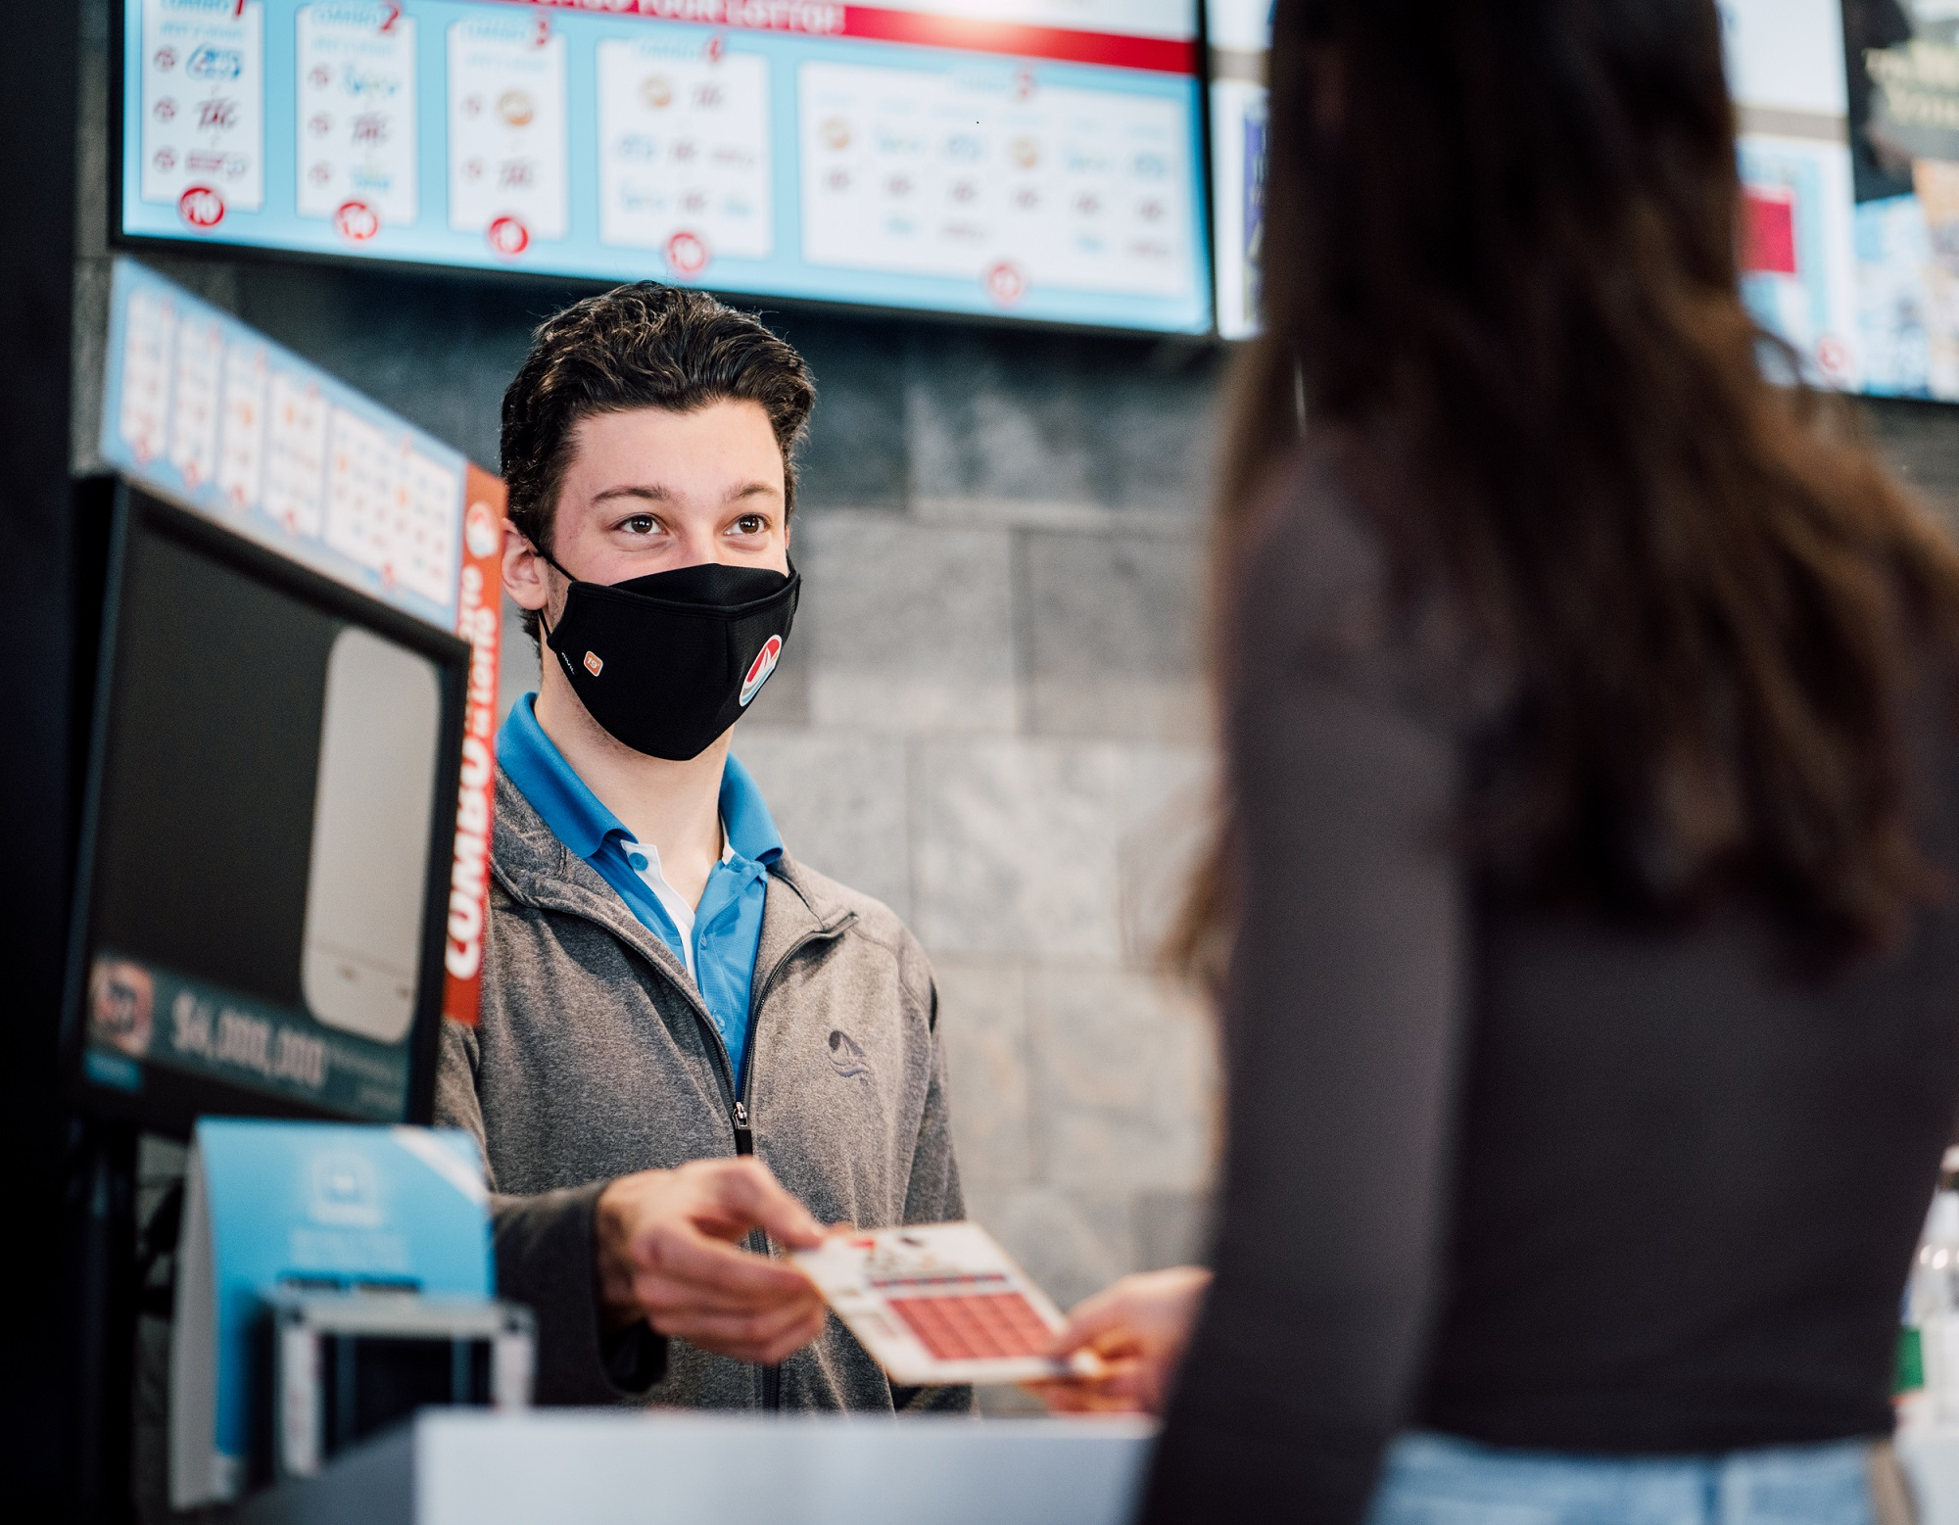
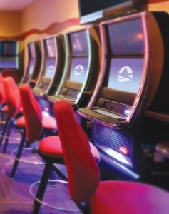
Partenariats avec les détaillants
Plus de 3 600 partenaires détaillants indépendants
Gains de 121,7 millions de dollars en commissions pour l’EF 2022-2023
Nouvelles façons innovantes d’améliorer nos espaces de jeu numériques et physiques

Slide 8
#LOTATLANTIQUE
11,6 milliards de dollars en lots attribués au Canada atlantique jusqu’à présent
En 2022-2023 :
440,1 millions de dollars en lots au Canada atlantique
892 grands gagnants (lot de 10 000 $ ou plus) au Canada atlantique
358 grands gagnants au Nouveau-Brunswick

Slide 9
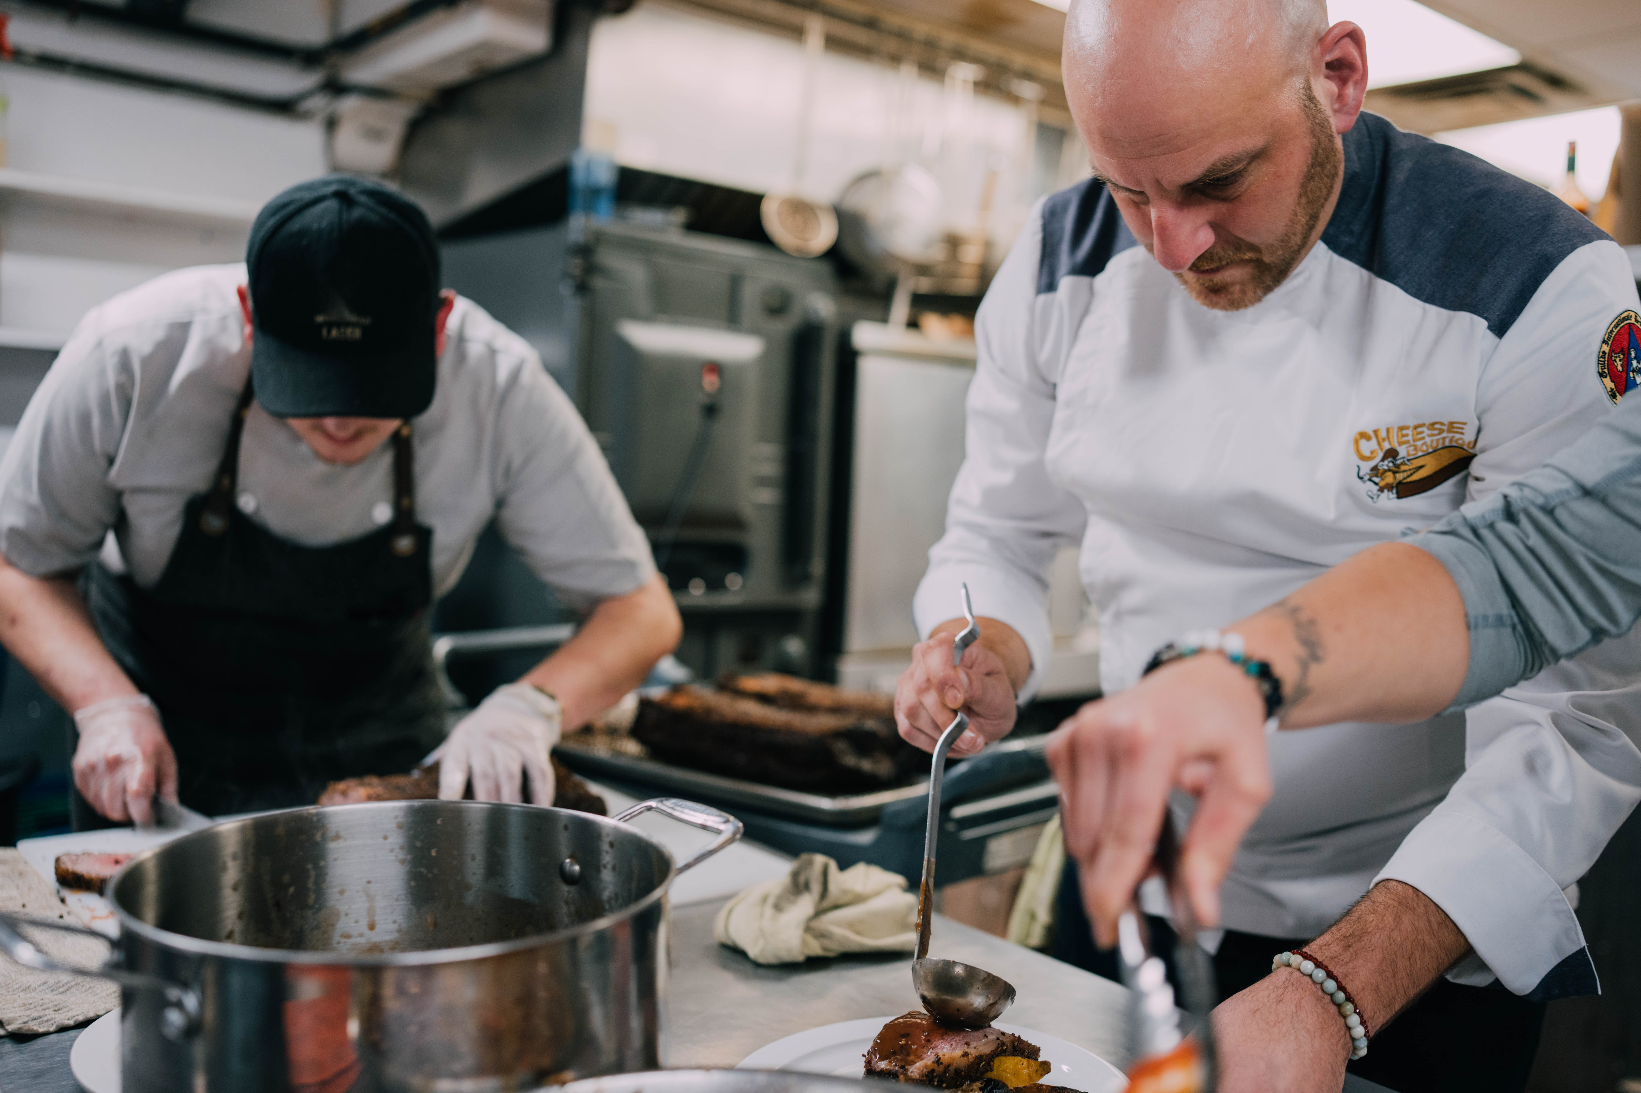
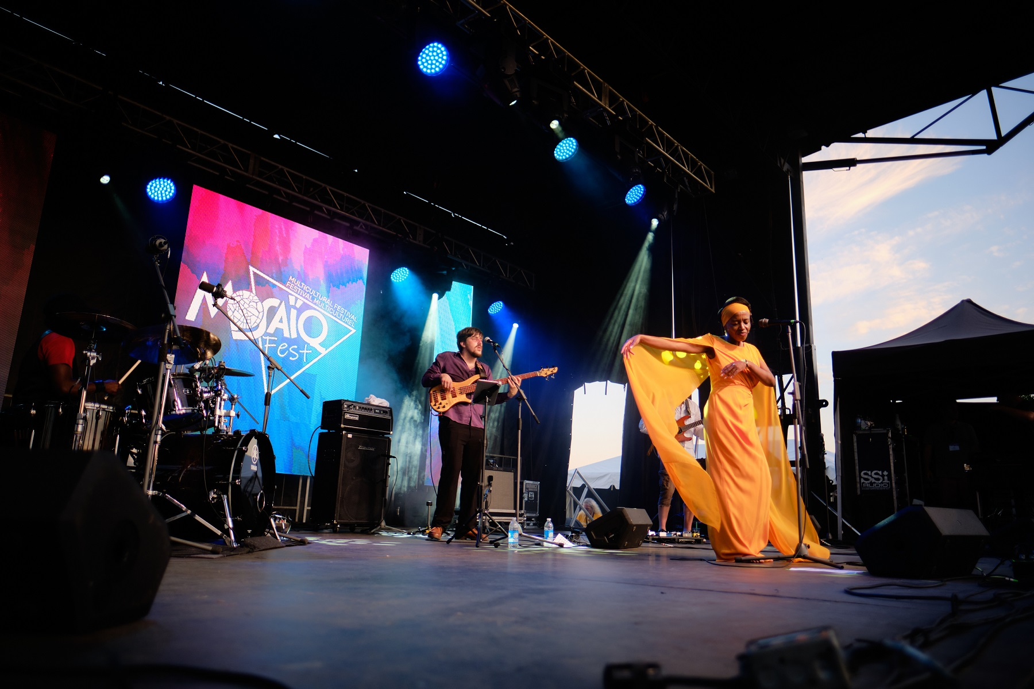
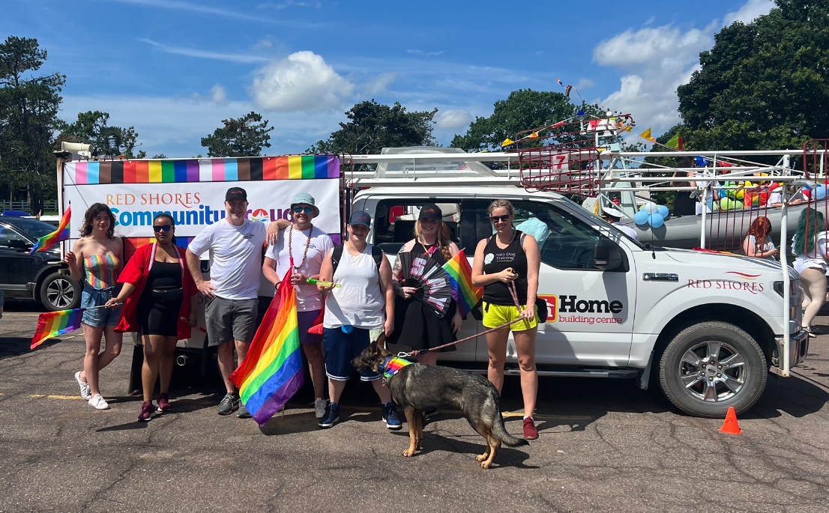
Commandite de plus d’une centaine de festivals et d’événements communautaires chaque année

Slide 10
Notes:
With that, I want to thank you for your time today and for having us here with you for the UMNB Annual Conference.
At Atlantic Lottery, we believe in leadership in our community and in our business. It’s how we contribute to the good things happening here – we’re not doing it alone; we’re simply doing our part and we appreciate all the incredible things that each and every one of you do for our local communities through the important work you do.
Our 2022-23 Annual Report was released last month and is available on alc.ca. If you’re interested in learning more, you can find additional details about all the things I discussed here today as well as in-depth financial results.

