Slide 2
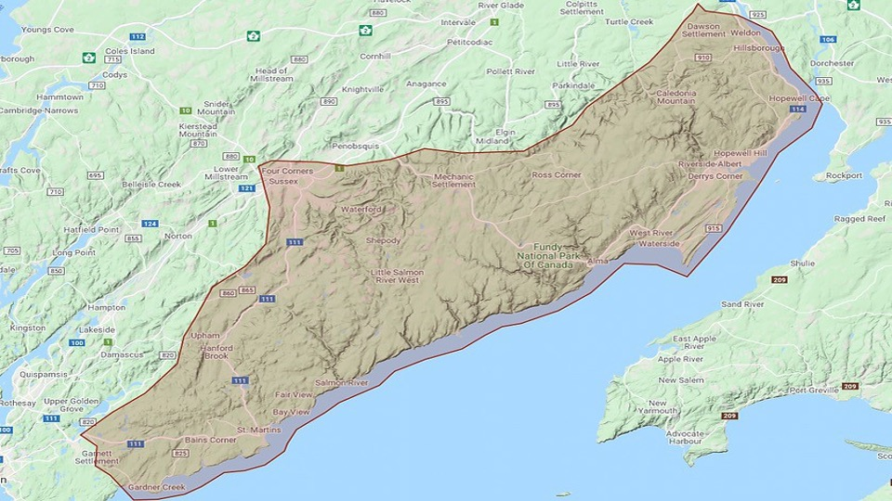
The Upper Bay of Fundy for Visitors
One of the highest concentrations of public investment in tourism infrastructure in Atlantic Canada
One national park
Fundy National Park
Three provincial parks
Fundy Trail Parkway
Hopewell Rocks
Cape Enrage
One private sector destination
Poley Mountain Resort

Slide 3
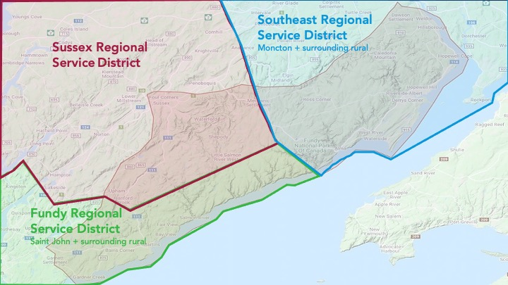
The Upper Bay of Fundy for Residents
Three Regional Service Districts
Southeast RSD (Moncton)
Sussex RSD
Fundy RSD (Saint John)
Three Municipalities
Fundy-Albert
Sussex
Fundy-St. Martins
Three Rural Districts
Southeast rural district
Kings rural district
Fundy rural district

Slide 4
Our Volunteer Working Group
Mike Carpenter, Bay of Fundy Adventures, St. Martins
Janet Clouston, Albert County Historical Society and Museum, Hopewell Cape
Dr. Jennifer D﻿ingman, Fundy UNESCO Biosphere Region and
Stonehammer UNESCO Global Geopark
Micha Fardy, Friends of Fundy, Alma
Jamie Hare, Poley Mountain Resort, Waterford
Bob Rochon, Mayor, Village of Fundy-Albert
Michelle Harvey-Larsen, Studio On the Marsh, Harvey & Albert County Tourism Association
Jordan Jamison, St. Martins & District Chamber of Commerce & Regional Tourism Association
Phyllis Sutherland, Ponderosa Pines Campground, Lower Cape & Fundy Tourism/Albert County Tourism Association
Jason Thorne, Community Services Director, Town of Sussex

Slide 5
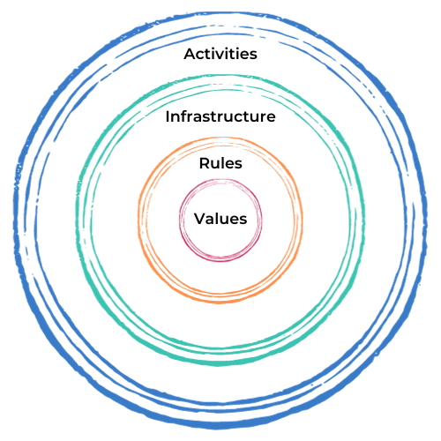
How Stable Systems Work

Slide 6
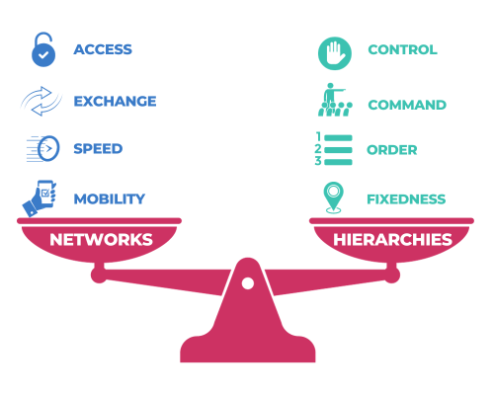
How Stable Systems Work

Slide 7
Our Core Values
Local Economies First
Shared Regional Benefits
Regenerative Year-Round Destination

Slide 8
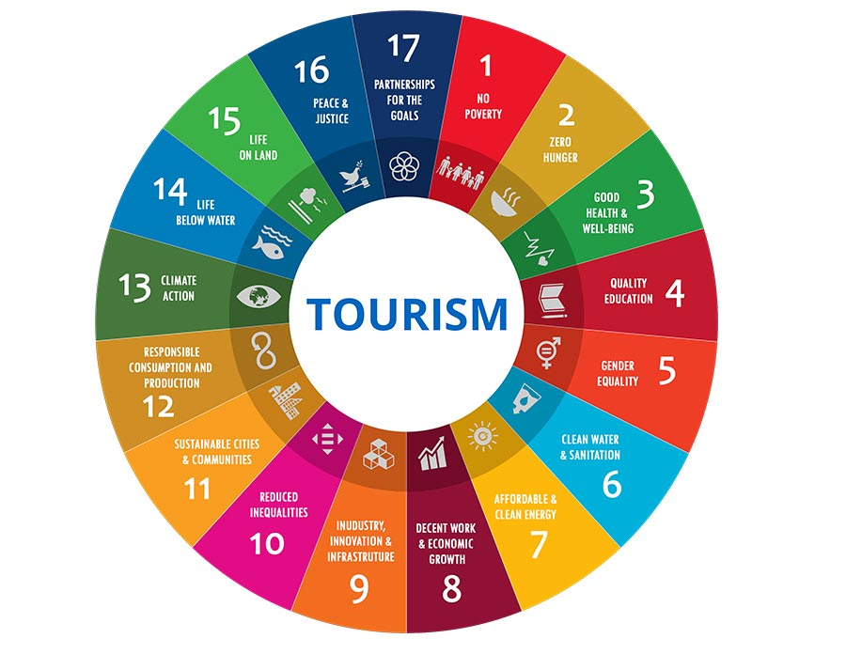
The UN Sustainable Development Goals

Slide 9
Our Approach

Slide 10
Our Work
Community Building & Facilitation
Research & Evaluation
Learning Events
Prototyping
Digital maps of
tourism assets
Digital footprint assessment
Heritage & culture inventory
Regional plans review 1996-2022
Community survey of attitudes towards tourism

Slide 11
Our Work
Community Building & Facilitation
Research & Evaluation
Learning Events
Prototyping
UN SDG regional readiness assessment
Fundy Connects! Summit
Regional trails conversation
Staff housing
Riverside-Albert Corner Routes 915 & 114

Slide 12
Our Work
Community Building & Facilitation
Research & Evaluation
Learning Events
Prototyping
JPrep Online Staff Training
Driftscape Self-guided Tour of Region
GreenStep Sustainability Assessment
Flourishing Canvas Strategy Pilot
Community presentations

Slide 13
Our Network
National / Outside New Brunswick/ Organizations
October 2022
3
Provincial Government
4
Municipalities and Chambers of Commerce
RUFP
6
12
Local Organizations

Slide 14
Our Network
National / Outside New Brunswick/ Organizations
October 2023
5
Provincial Government
7
Municipalities and Chambers of Commerce
RUFP
7
24
Local Organizations

