Slide 1
Local Choice-Local Voice
Union of Municipalities of New Brunswick
October 5, 2019

Slide 2
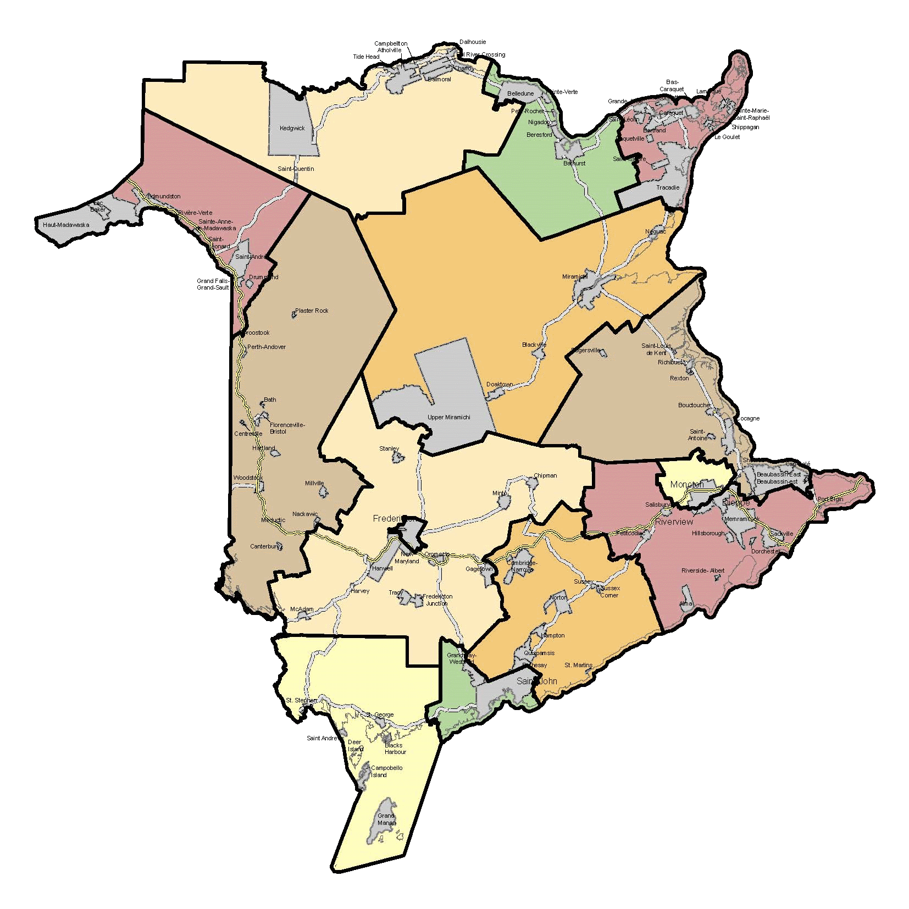
Municipal Council Positions to Elect
104 Municipalities:
104 Mayors
542 Councillors

Slide 3
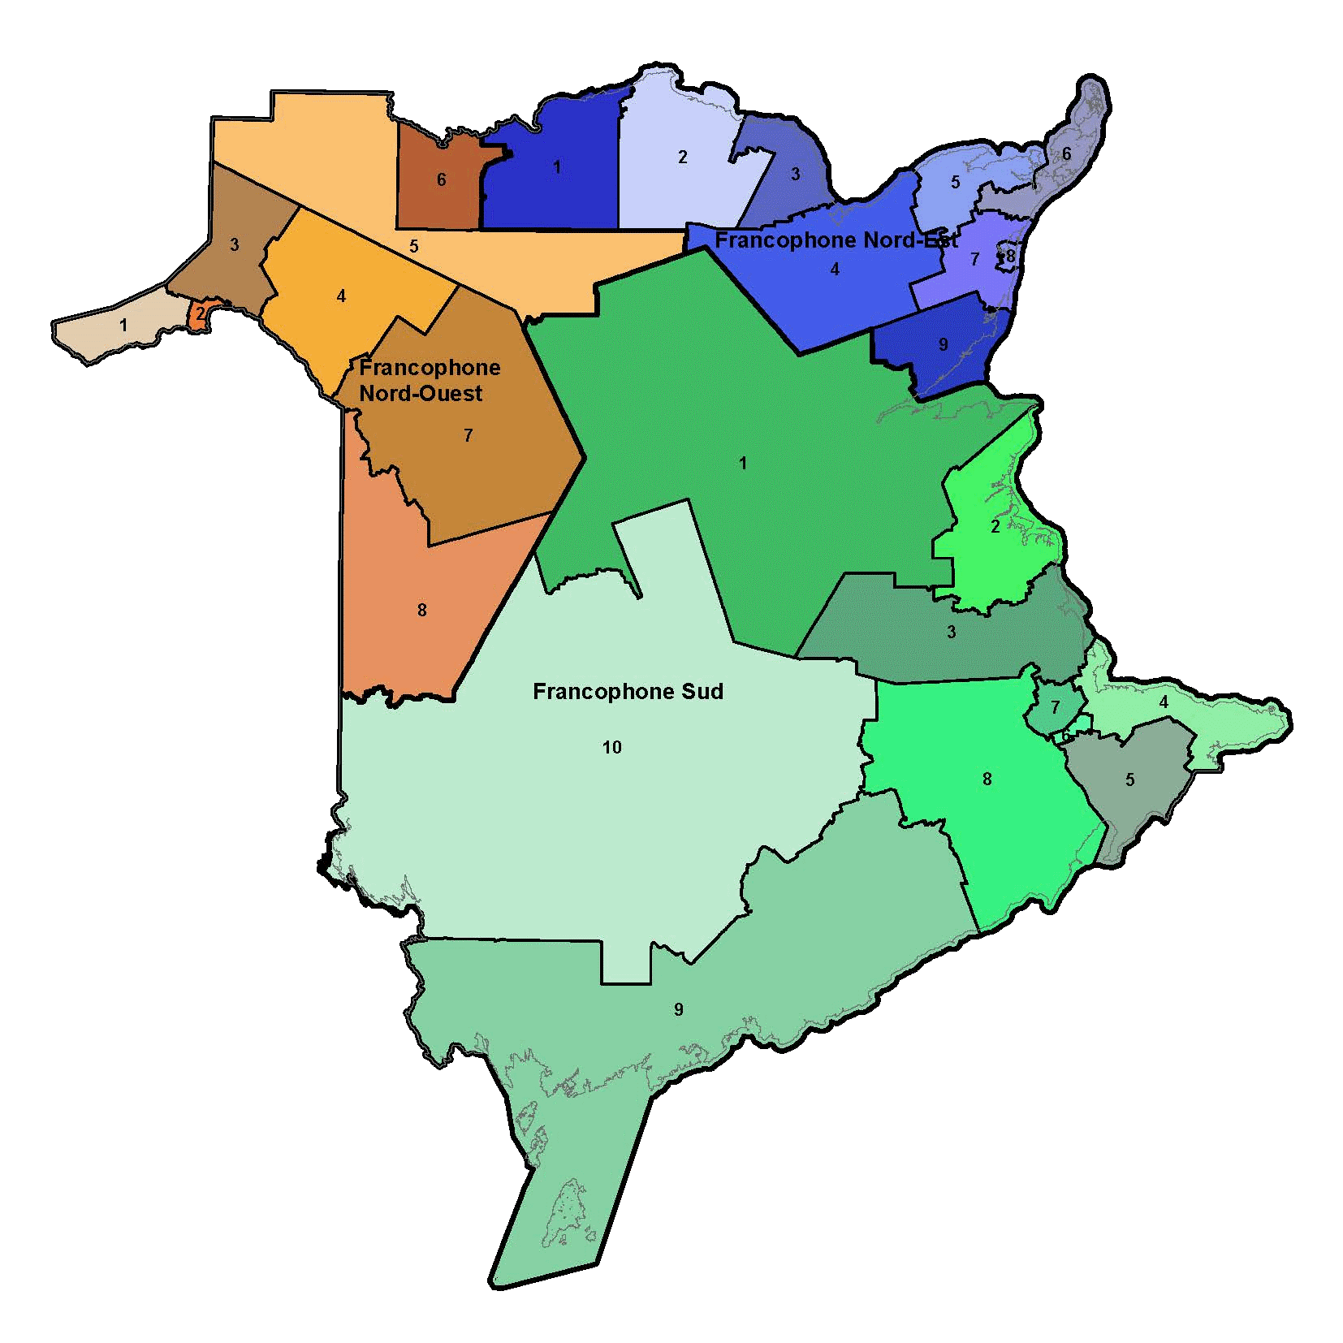
DEC Positions to Elect
4 Anglophone School Districts:
- 41 subdistricts
- 1 Councillor per subdistrict
3 Francophone School Districts:
- 27 subdistricts
- 1 Councillor per subdistrict

Slide 4
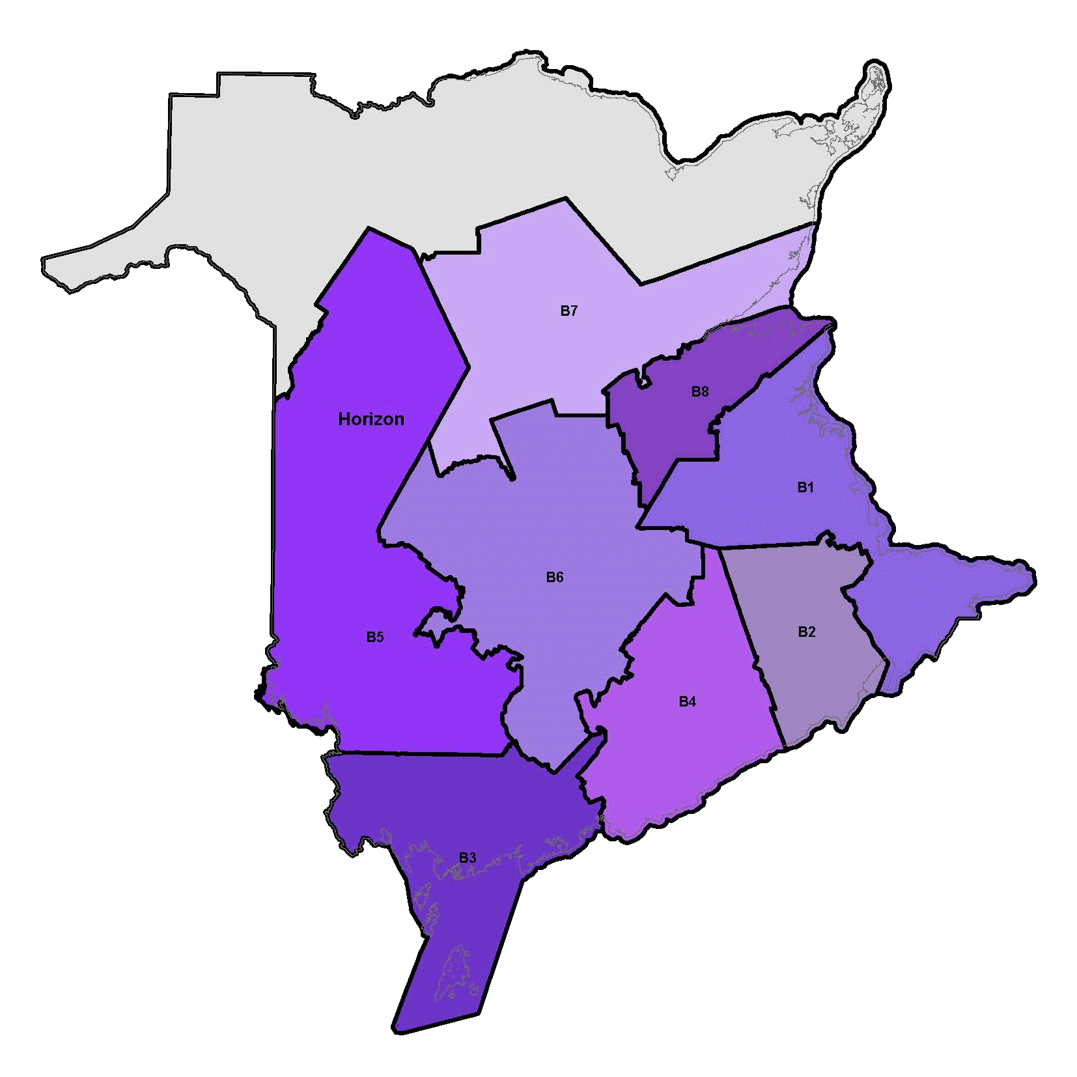
RHA Positions to Elect
Regional Health Authority A
(Vitalité):
- 8 subregions
- 1 member per subregion
Regional Health Authority B (Horizon):
- 8 subregions
- 1 member per subregion

Slide 5
MUN Council Positions: Vacant, Acclaimed, Elected

Slide 6
DEC Council Positions: Vacant, Acclaimed, Elected

Slide 7
RHA Council Positions: Vacant, Acclaimed, Elected
No RHA elections Held

Slide 8
Female Council Positions Nominated & Elected

Slide 9
Comparison of Provincial and Municipal Trends

Slide 10
Candidate Recruitment
Theme for May 2020 local elections “Local Choice-Local Voice”
Partnership with Local Government, Department of Education and Department of Health

Slide 11
Candidate Recruitment
Province-wide speaking tour to promote the elections
Social media campaign running on multiple platforms

Slide 12
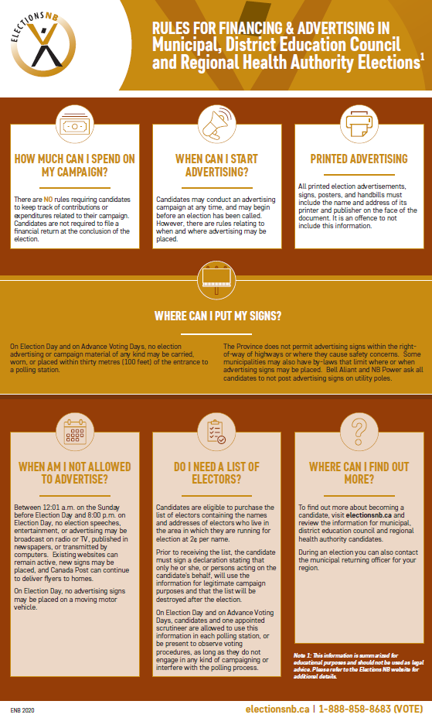
Candidate Recruitment
Information fact sheets for prospective candidates
Promote candidate information on Elections NB website

Slide 13
Sunday | Monday | Tuesday | Wednesday | Thursday | Friday | Saturday
Mar 22 -50 | Mar 23 -49 MRO Office opens to public | Mar 24 -48 | Mar 24 -47 | Mar 26 -46 | Mar 27 -45 | Mar 28 -44
Mar 29 -43 | Mar 30 -42 | Mar 31 -41 | April 1 -40 | April 2 -39 | Apr 3 -38 | Apr 4 -37
Apr 5 -36 | Apr 6 -35 | Apr 7 -34 | Apr 8 -33 | Apr 9 -32 Nominations Close @ 2 p.m. | Apr 10 -31 Good Friday | Apr 11 -30
Apr 12 -29 Easter (offices closed) | Apr 13 -28 Easter Monday (offices closed) | Apr 14 -27 Withdrawal Deadline 5 pm | Apr 15 -26 | Apr 16 -25 | Apr 17 -24 | Apr 18 -23 Grant of Poll Insert
Apr 19 -22 | Apr 20 -21 Special Ballots Available | April 21 -20 | April 22 -19 | April 23 -18 | April 24 -17 | April 25 -16
April 26 -15 | April 27 -14 Voter Information Cards | April 28 -13 | April 29 -12 | April 30 -11 | May 1 -10 | May 2 -9 Advance Poll 10 am – 8 pm
May 3 -8 | May 4 -7 Advance Poll 10 am – 8 pm | May 5 -6 | May 6 -05 | May 7 -4 Revision Ends | May 8 -3 | May 9 -2
May 10 -1 | May 11 0 Election Day 10 am – 8 pm | May 12 1 | May 13 +2 Declaration Day | May 14 +3 | May 15 +4 | May 16 +5
May 17 +6 | May 18 + 7 | May 19 +8 | May 20 +9 | May 21 +10 Recount Deadline | May 22 +11 Offices disconnected

